Slide 1
Bakkle – Upload Speed

Slide 2
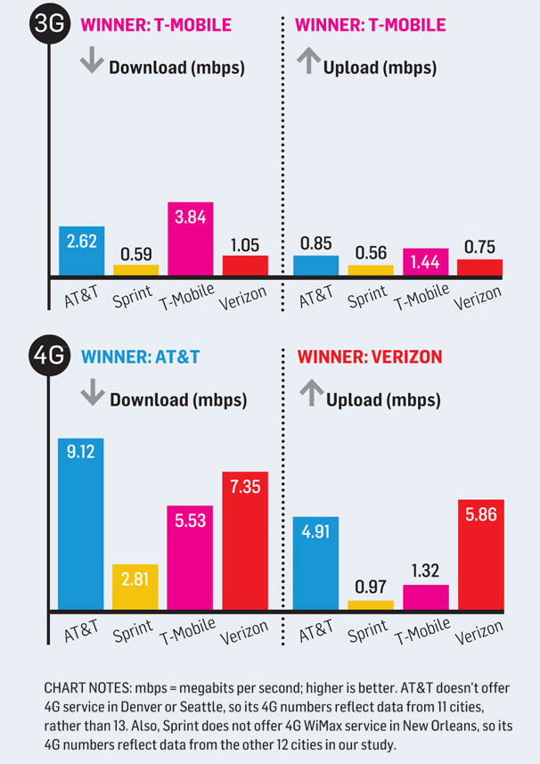
Provider Upload Speeds (3G, 4G)
*Mbps (megabits per sec)
*13 large cities coast-coast
*Different phones per provider
*April 16, 2012
*Methodology: http://www.pcworld.com/
*Data: http://www.pcworld.com/
Notes:
These tests are old, though they are actual tested speeds from actual people in large cities around the U.S.
Even though the data was received by an actual cell phone, the number still seem very high

Slide 3
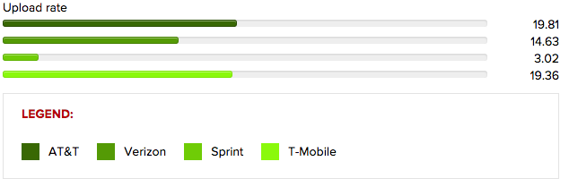
Provider Upload Speeds (4G LTE)
*Mbps (Mega-bits per second)
*Ookla’s Speedtest.net app
*Same place in San Jose, CA
*LG G3, factory reset before test
*5 Tests: same time on weekend, 5 weekends
*Published August 5, 2014
*http://www.cnet.com/

Slide 4
Provider Upload Speeds (4G LTE Cont.)
*One more set of LTE Data:
*AT&T: 9.0 Mbps
*Verizon: 8.5 Mbps
*Sprint: 4.4 Mbps
*T-Mobile: Unavailable at time of testing
*Details of tests not included
*Mar 11, 2013
*http://bgr.com/
Notes:
The details of this test were not included in the article, though it gave a slower speed for two of the 4 cell phone service providers.
In the calculations, the slowest speeds were used (when available).

Slide 5
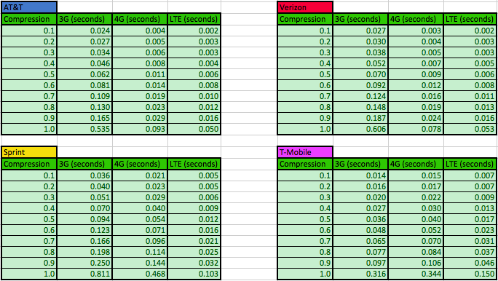
Calculated Times for Average Image Size
Notes:
The bit count per image compression was found by taking 31 photos on the Bakkle app with an iPhone 5.
Each image was then compressed 10x into a JPEG and the bit count was then added in a pool of their respective compressions.
The final bit count average was reported AFTER the image count was > 30 images.
The images taken were of random items around our office, both in focus and out of focus pictures were taken, as well as pure black images, and noisy images (covered camera: flash and no flash) to get the largest variety of image sizes.
The equation to solve for elapsed upload time is: Size (Kb) * 1 Mb / 1000 Kb * 1 sec / Speed (Mbps)

Slide 6
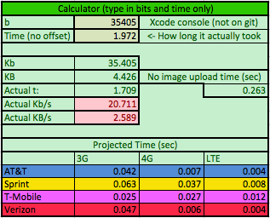
Calculator
*Link to spreadsheet
*Also located in docs folder of git
Notes:
In the spreadsheet, there is also a calculator to show how long the upload SHOULD have taken according to the average upload speeds given.
The actual time taken to upload the image is calculated by subtracting the amount of time that it takes to post an item without any image (DNS lookup / server-device communication / other data transfer)
Both the bit count and the time (no offset) were printed to the Xcode console, both of which are not printed out on the most recent build.
The code currently resizes the image in AddItem and then compresses to a JPEG after the confirm upload button is clicked, though the time taken to upload is negligible.
The example shown above has the bit count of an actual image taken and the time to upload, with modified code to have the image compressed immediately after the resize.
Possibly make it so the image keeps compressing into a JPEG until its bit count drops below a minimum value?

Slide 7
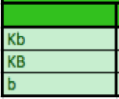
Average Image Size (enlarged)

Slide 8
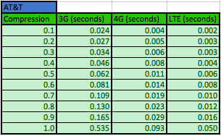
Upload Time Enlarged (At&t)

Slide 9
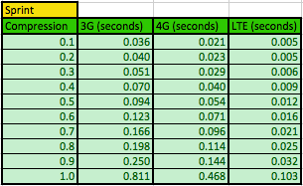
Upload Time Enlarged (Sprint)

Slide 10
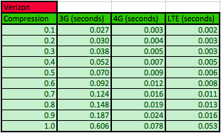
Upload Time Enlarged (Verizon)

Slide 11
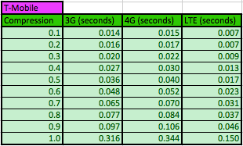
Upload Time Enlarged (T-Mobile)

